Slide 2
12 Sept
- Azure Synapse is an enterprise analytics service that accelerates time to insight across data warehouses and big
data systems. Azure Synapse brings together the best of SQL technologies used in enterprise data warehousing, Spark technologies used for big data, Data Explorer for log and time series analytics, Pipelines for data integration and ETL/ELT, and deep integration with other Azure services such as Power BI, CosmosDB, and AzureML.
- Synapse always need a storage acc
- All the data will be stored on the storage acc and it should be gen2
- if we make a synapse service, it will automatically ask us to create a gen2 storage accc
- on develop we can make notebooks
- integrate IR , pipelines
- each and everything needs a different computing unit
- serverless and dedicated sql pool
- serverless fully managed by azure or any other service provider. Don’t have to worry about maintenance.
-

Slide 3
12 Sept
- serverless - table not supported
- The main difference between dedicated VM and serverless option is that
- dedicated VMs provide a fixed amount of resources that are allocated to the VM,
- while serverless options provide resources on demand and scale automatically based on usage
- data integration unit(DIU) using this Data warehouse calculates the cost
- Openrowset is a function used to read the file
- OPENROWSET is a T-SQL function that allows for reading data from many sources including using the SQL Server's BULK import capability
- we can create the database inside using code or UI.
- UTF - collate is used to enable some special characters
create db1 collate Latin1_general_100_BIN2_UTF8
- Common table expression

Slide 4
12 sept
- CTE cant run alone
- When we want to visualize the data we go for serverless, as using dedicated service will be cost ineffective
and cant be running 24/7.
- how hash helps change data capture - when
- based on the hash value , the data gets distributed on the compute node. thats when its called hash distributed
- clustered columnstore, clustered index , heap

Slide 5
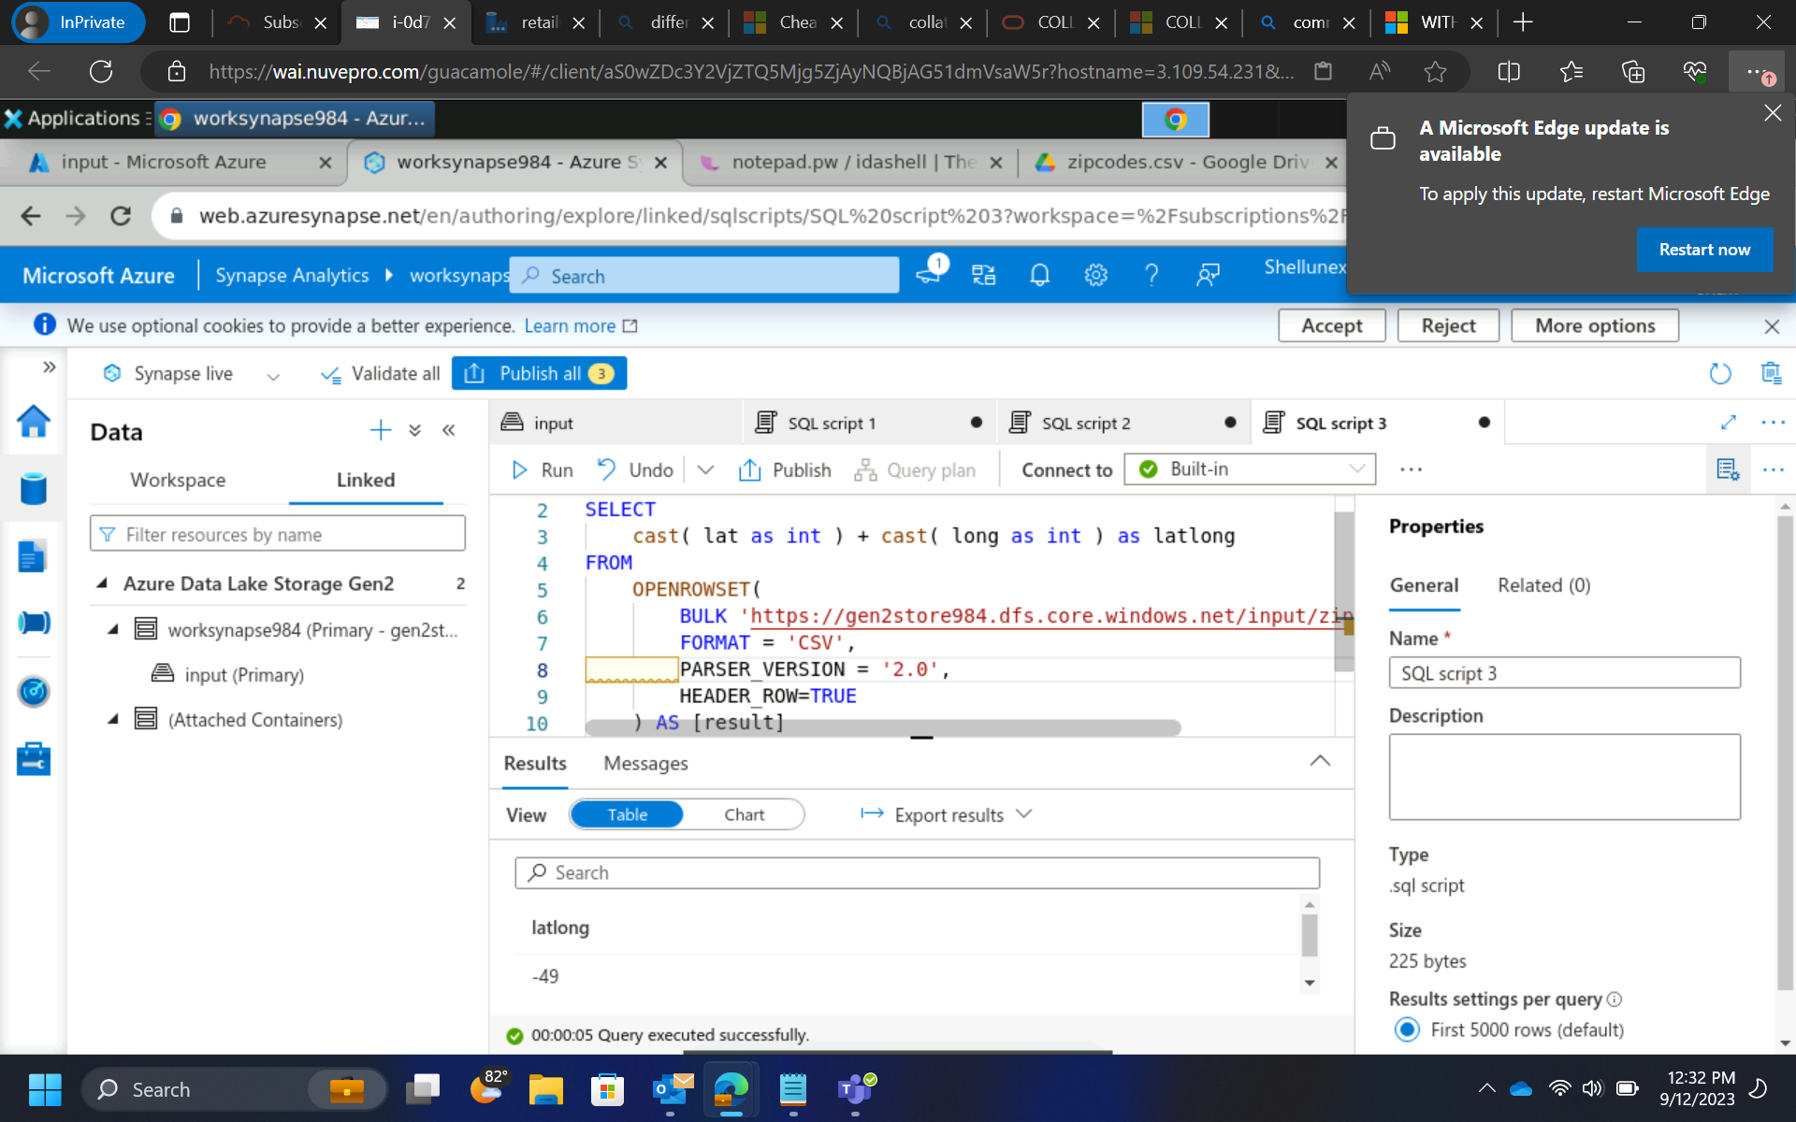
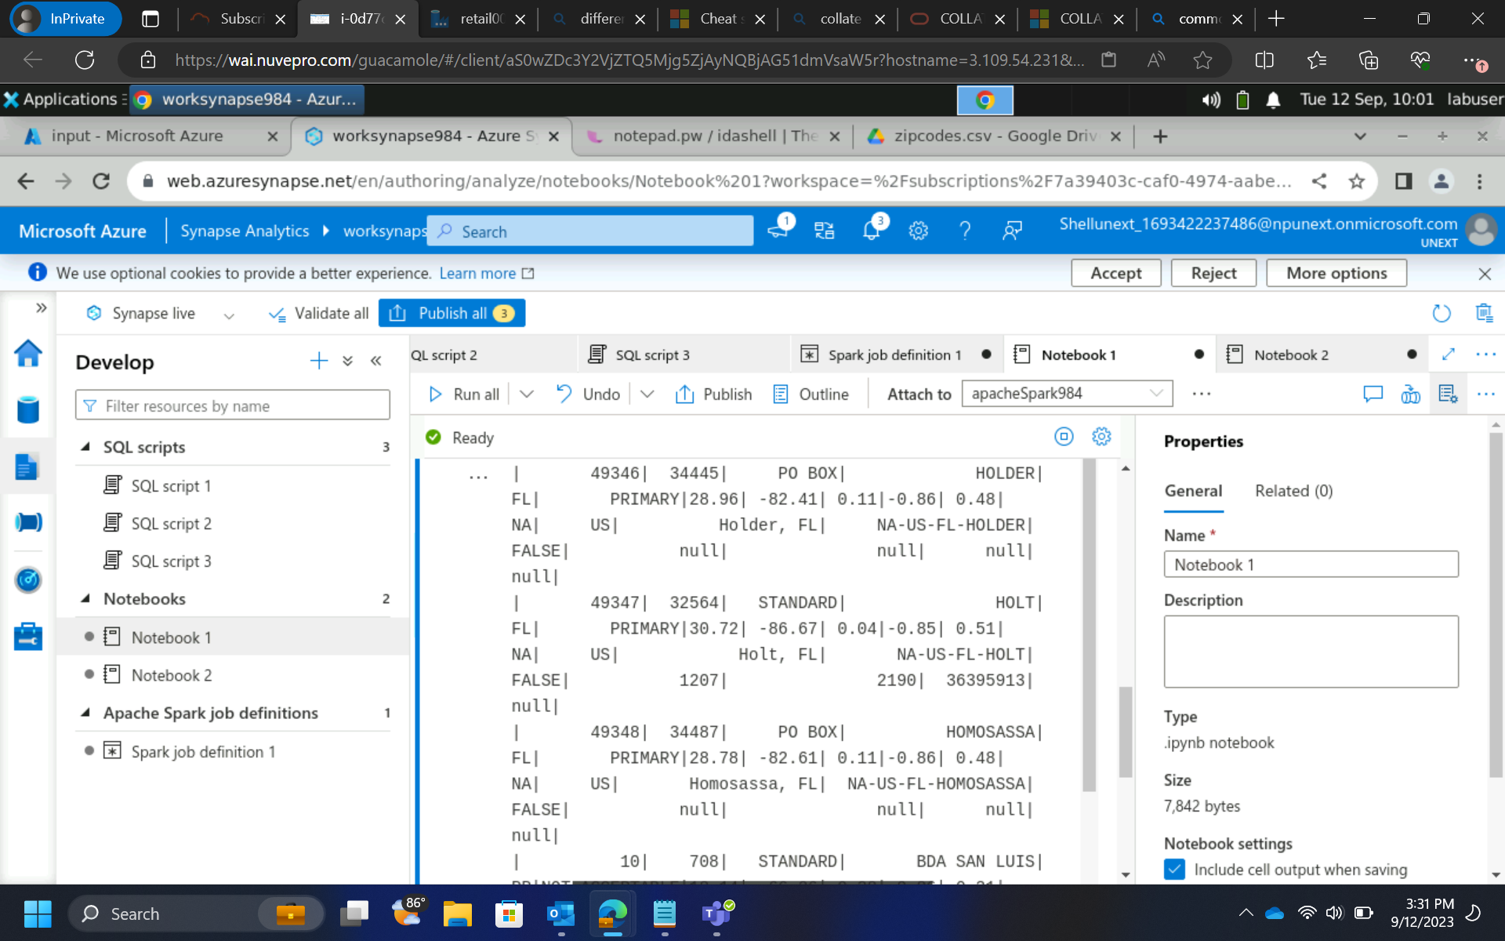

Slide 6

13 sept
Power Query Editor Tx
- DAX measures
- DAX calculated columns
- Filters ( Visual, Page, All Page)
- Slicer
- RLS ( manage roles)
- Beautification
- Parameter for our sources

Slide 7
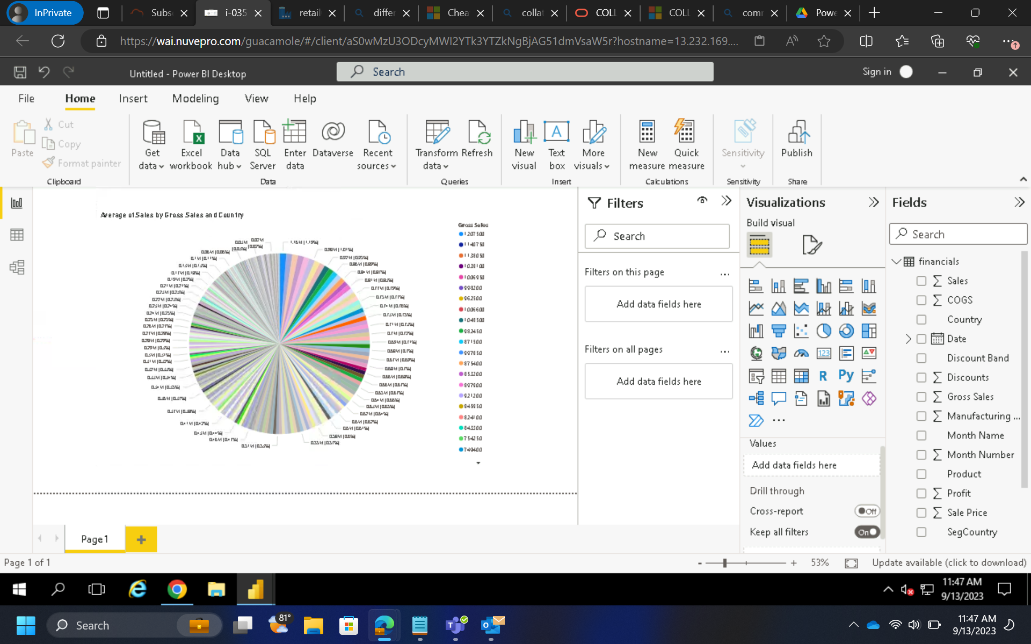
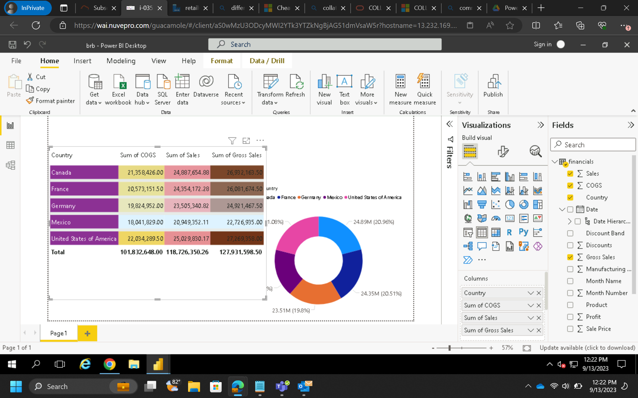
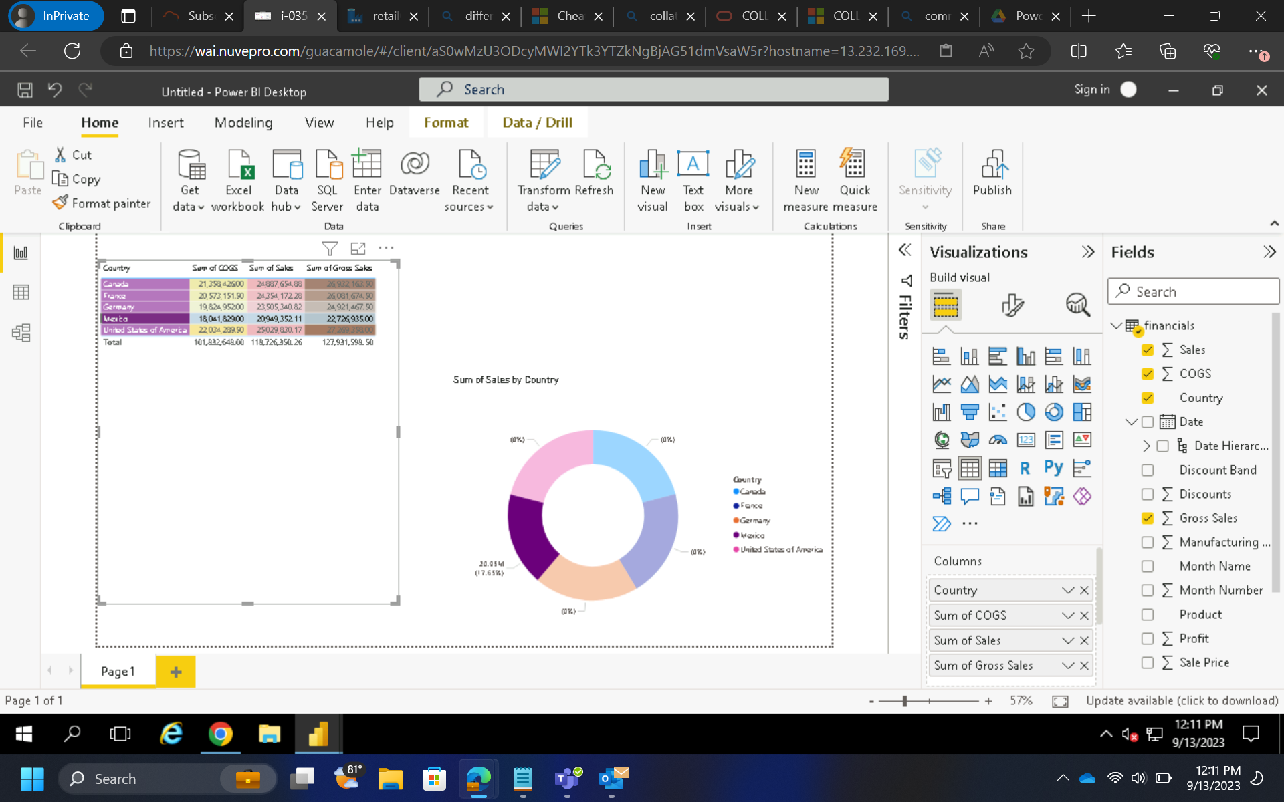
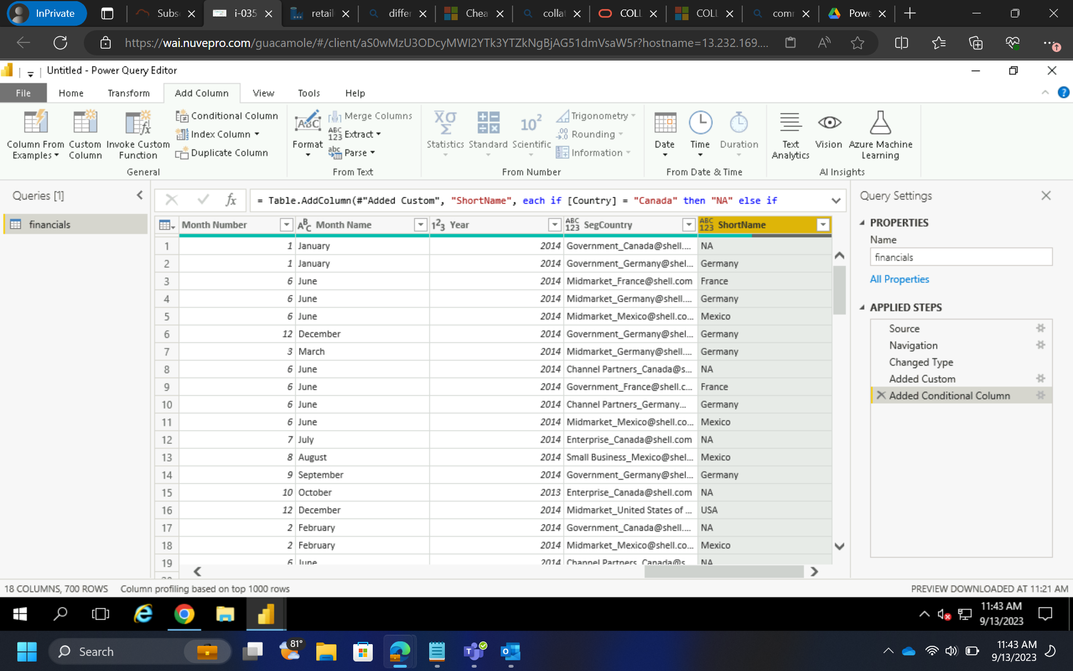

Slide 8
14 sept
Loading csv files in PowerBI
Relationship between entities
Univariant, Bivariant, multivariant
Hands on activities
Parameter
Power query editor
DAX
Filters
Slicer
Tables
Beautification
Connecting to SQL Management server

Slide 9
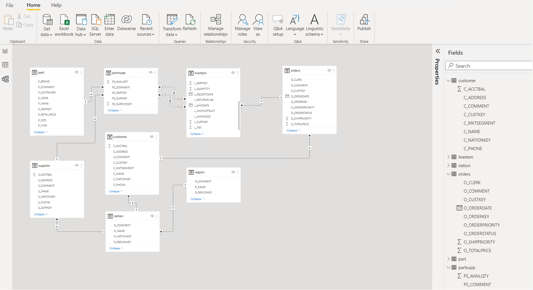
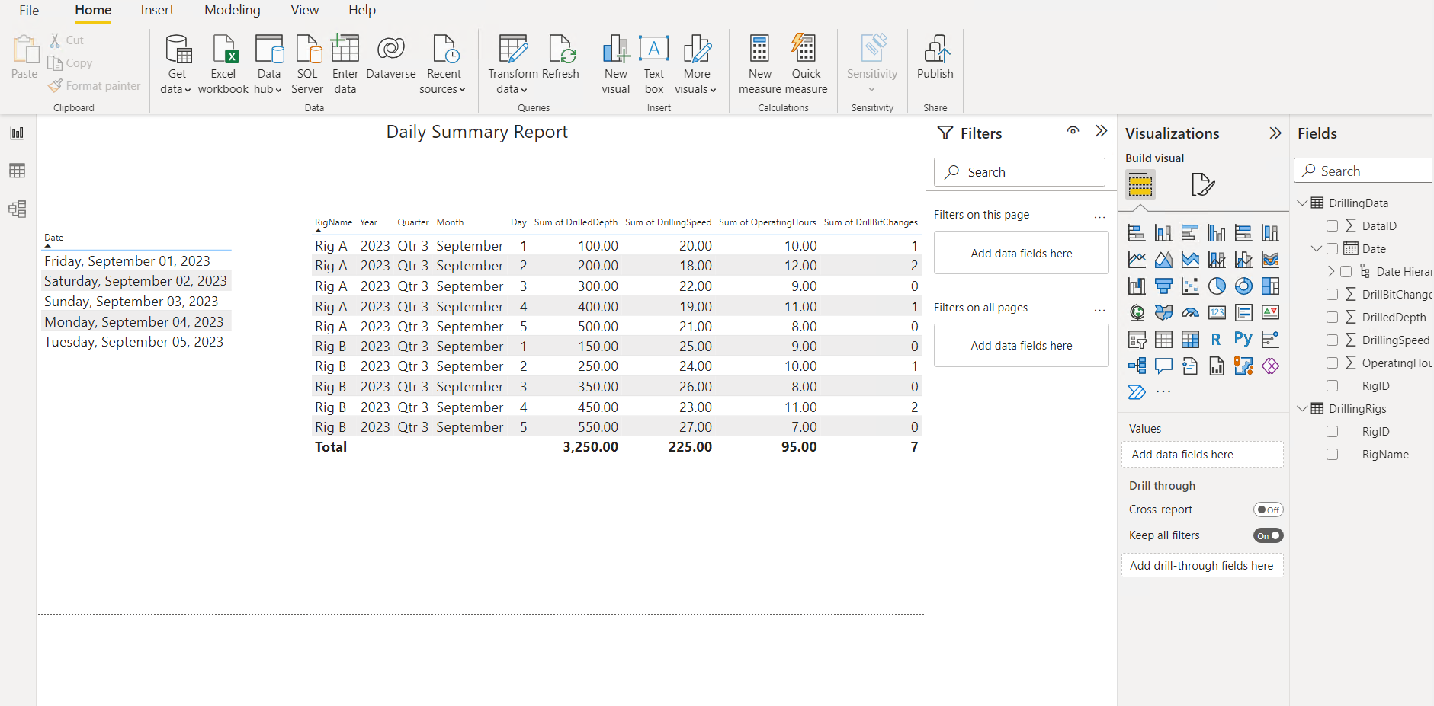
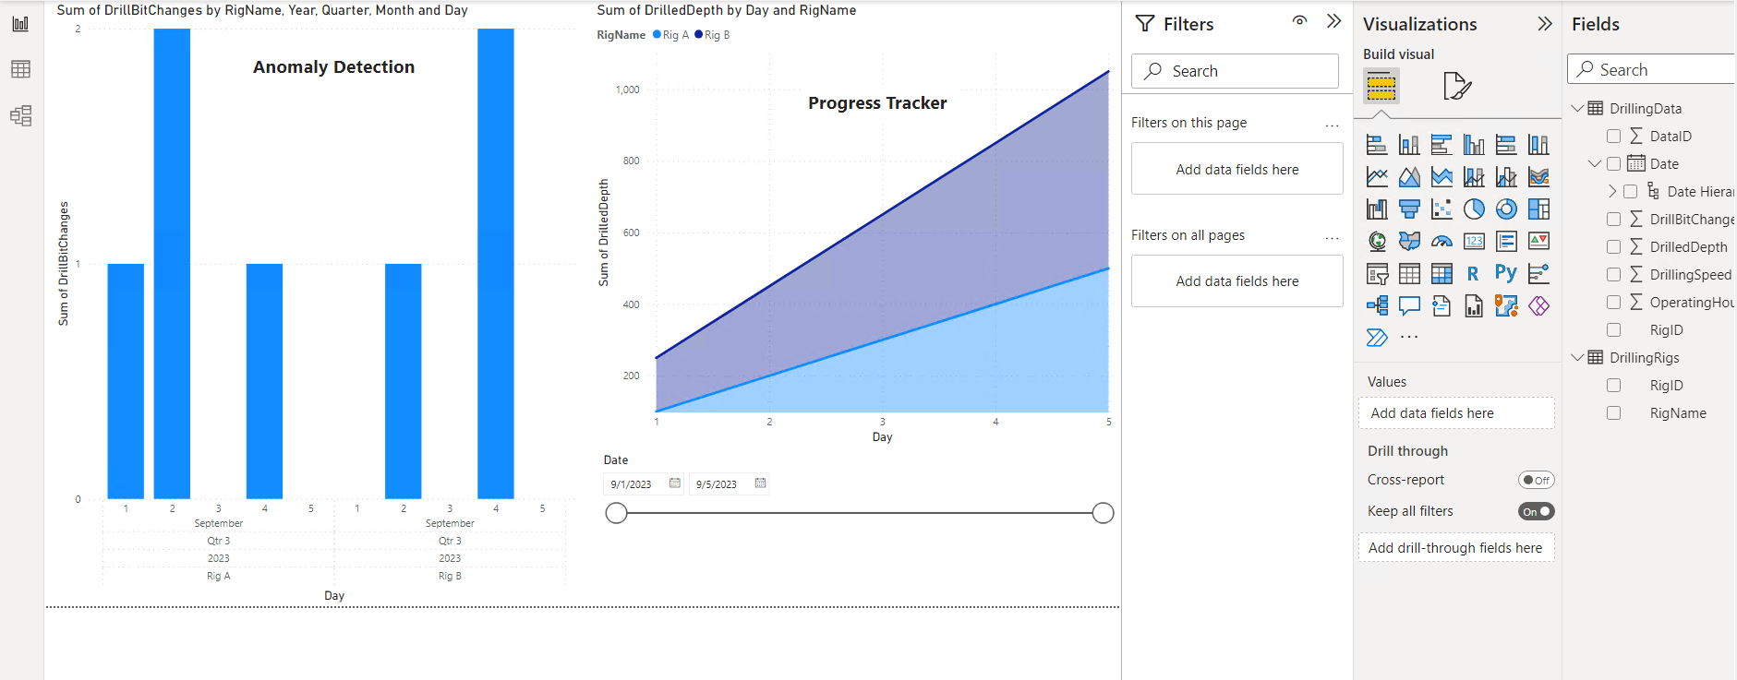

Slide 10
15 sept
Case study – PowerBI
Introduction to python
Integer
Float
String
Boolean
List
Tuple
Dictionary
Operators
Functions

Slide 11
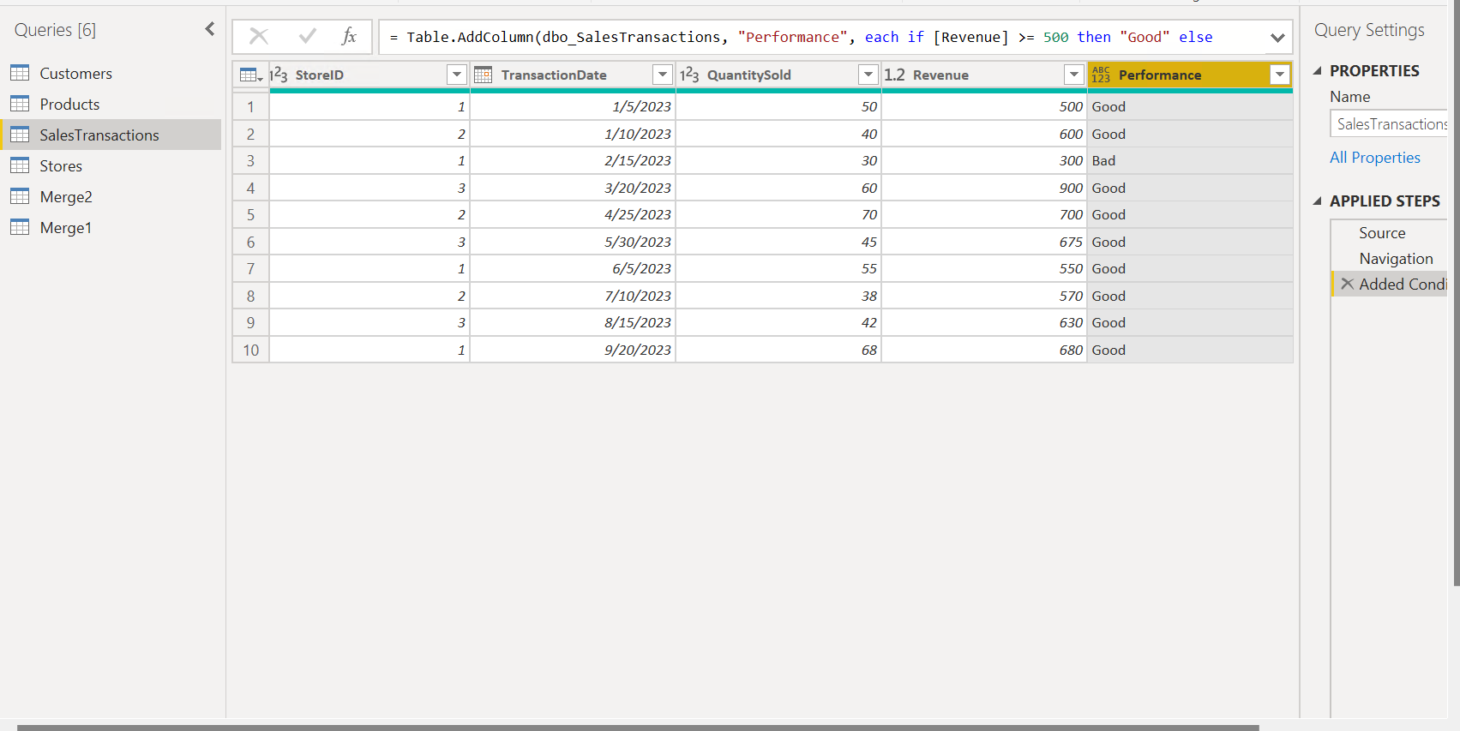
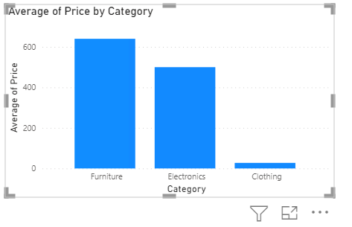
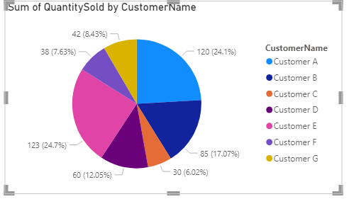
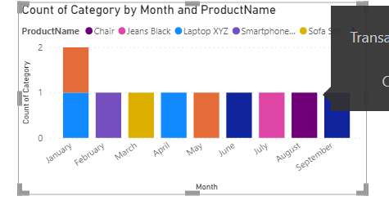
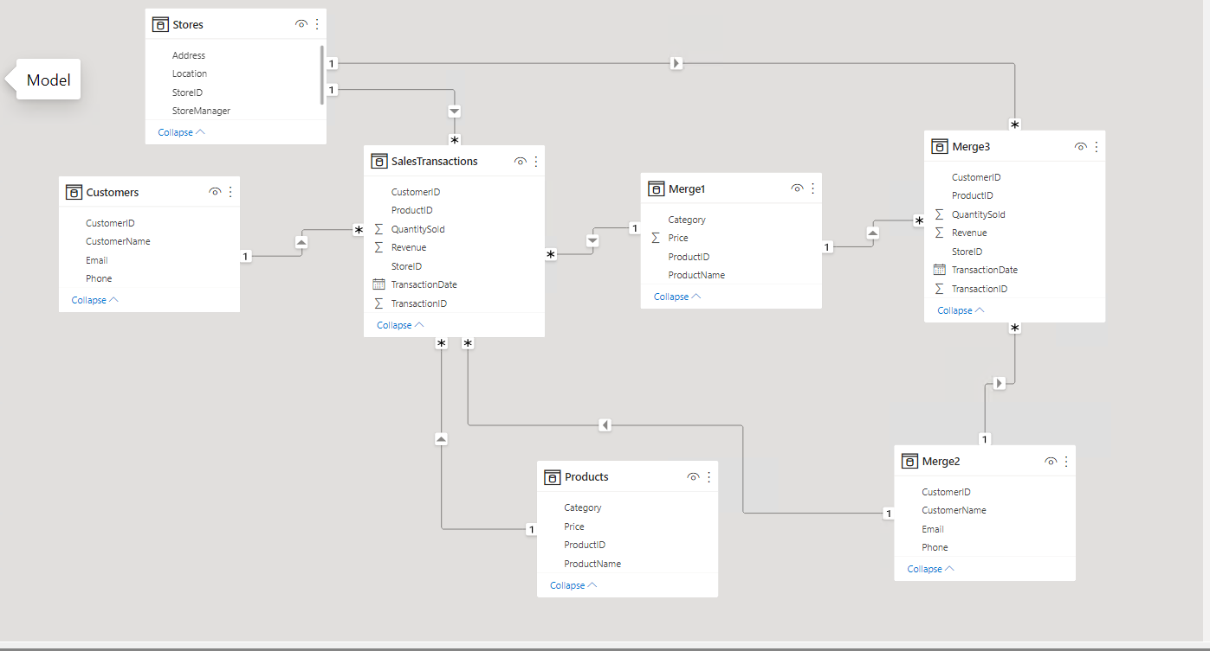
15 sept

Slide 12
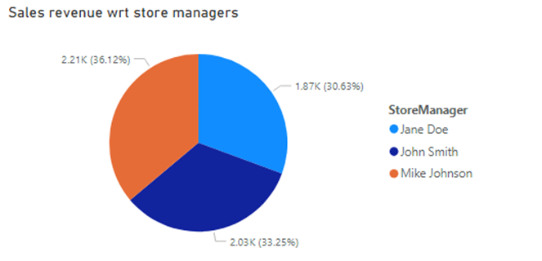
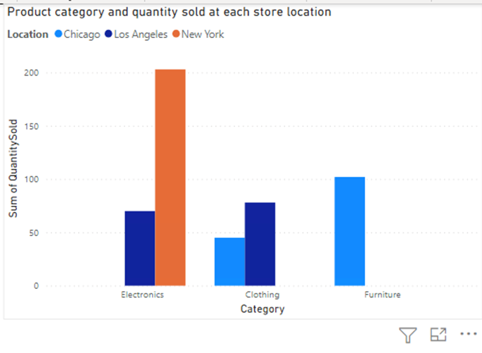
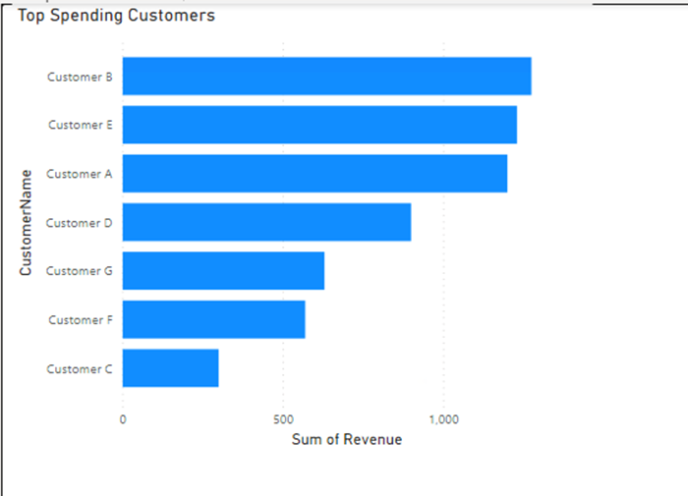
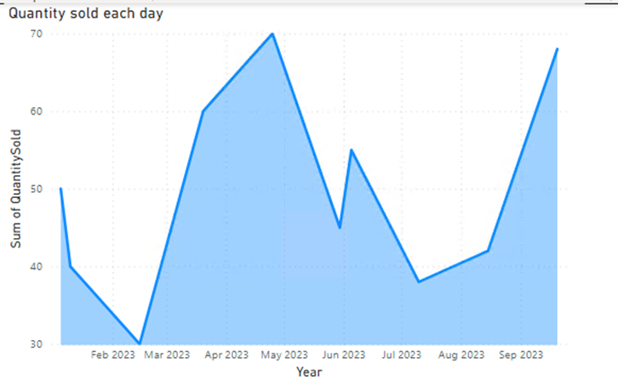

Slide 13
